Slide 1
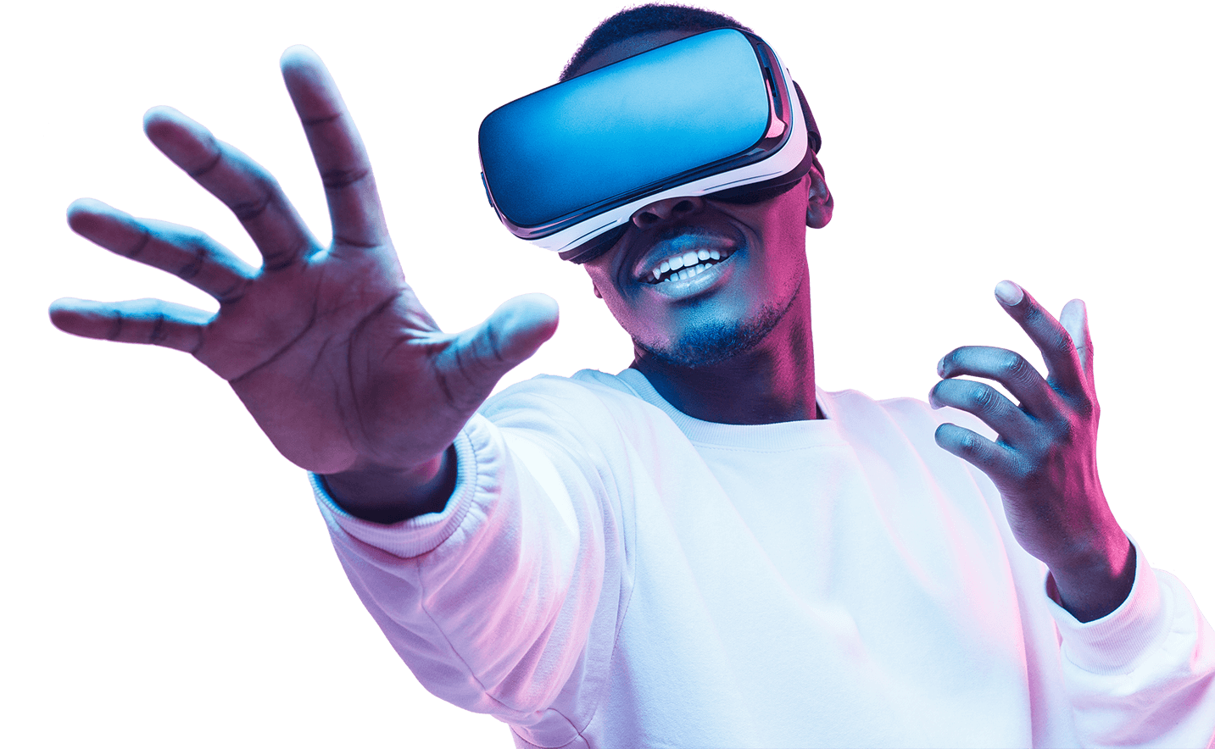
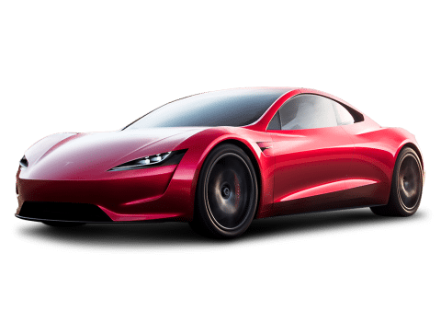
Driver Attentiveness in Virtual Reality
Professional Project (COM3001)
Student: James Wright
Supervisor: Dr. Steve Wesemeyer

Slide 2
Project Aim
The aim of the project is to investigate how different scenarios can positively or negatively effect a driver’s reaction time whilst driving a car.
Short-Term: Give information into which technologies (current or new) aid or distract drivers.
Long-Term: Help to push government regulations, inspire companies/entrepreneurs to create new technologies, ultimately - reduce road deaths.

Slide 3
Background knowledge

Slide 4
Literature Review: Key Points
On average, in Great Britain, 5 people die per day on the road and many more are injured. With the majority of the fatally injured being drivers & passengers [1].
Speeding and Distractions make up nearly 50% of the named causes for road fatalities [2].
Demographic data for subjects should be recorded (age, sex, race, economic status, etc.) as from previous similar studies it suggested these variables may be an important factor in fatigue [4] hence accident likelihood of a subject [5].
Risk perception of the driver is a key factor in whether they will crash or not, independent of driver skill [6] – implying driving skill is not a significant factor, the overconfidence of a driver is.

Slide 5
Literature Review: Key Points
Virtual Reality Sickness Questionnaire (VRSQ) or a Simulation Sickness Questionnaire (SSQ) can be used to measure motion sickness when testing [7] – recommended to minimise motion sickness in the final build of the application.
Maximum of 30 minutes of virtual reality simulation per person recommended to minimise motion sickness [8] (along with other similar information in [9], [11], to minimise motion sickness in VR)
“a virtual emergency can be staged in a virtual environment since users would acknowledge it as such” [10] – this whole study adds credibility that the results from my experiment will be reliable, as they conclude that users treat virtual situations seriously. Hence, they will try and react correctly & as fast as possible in a “dangerous” situation (car accident in this context).

Slide 6
Literature Review: References
[1] https://www.brake.org.uk/facts-resources/1653-uk-road-casualties - Brake UK 2017 report on road casualties.
[2] https://www.aceable.com/safe-driving/car-accident-statistics/ - Aceable US driving fatality data (2007 – 2012).
[3] https://www.regtransfers.co.uk/content/common-causes-for-road-accidents-in-britain/ - latest statistic from the department of transport (in Britain) for the most common causes of road traffic accidents (published 2nd July 2018).
[4] https://www.sciencedirect.com/science/article/pii/S0001457509003327 - Accident Analysis & Prevention (Volume 43, Issue 2, March 2011, Pages 516-532)
[5] https://www.nsc.org/road-safety/safety-topics/fatigued-driving#:~:targetText=A%20study%20by%20the%20AAA,times%20the%20police%2Dreported%20number.&targetText=NHTSA%20estimates%20fatigue%2Drelated%20crashes,annually%2C%20not%20including%20property%20damage. – National Safety Council article on “drowsy driving” (2019)
[6] https://www.sciencedirect.com/science/article/pii/S0001457513003497?via%3Dihub - Accident Analysis & Prevention (Volume 62, January 2014, Pages 63-78)
[7] https://www.sciencedirect.com/science/article/pii/S000368701730282X - Applied Ergonomics (Volume 69, May 2018, Pages 66-73)
[8] https://www.businessinsider.com/virtual-reality-vr-side-effects-2018-3?r=US&IR=T#loss-of-spatial-awareness-1 – Business Insider “Here's what happens to your body when you've been in virtual reality for too long” by Kaylee Fagan (Mar 4, 2018, 4:00 PM)
[9] https://search.proquest.com/docview/1877838144?accountid=17256&rfr_id=info%3Axri%2Fsid%3Aprimo - Experimental Brain Research (Volume 235, Issue 3, Pages 889-901)
[10] https://www.sciencedirect.com/science/article/pii/S0747563215000540?via%3Dihub - Computers in Human Behavior (Volume 48, July 2015, Pages 104-113)
[11] https://uxplanet.org/motion-sickness-in-vr-3fa8a78216e2 - Motion Sickness in VR by Anastasiia Ku (Nov 29, 2018)

Slide 7
Development Work

Slide 8
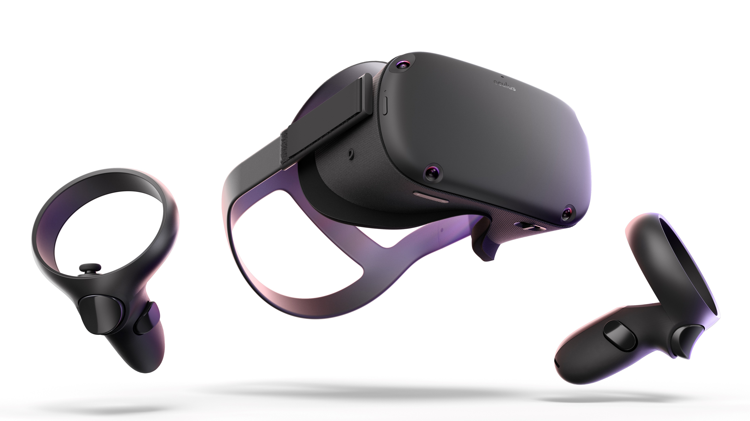


Receives user input & calculates result, outputs results to a local file (encrypted)
Exports application to the oculus device
User inputs button press in reaction to stimuli
Oculus Quest (VR)
Runs application
Screen records the user’s test
Transfers data from oculus (results & screen recordings) to the computer
User
Development Software
Gives written & verbal consent to do test and to use their data
Tells the user the instructions, and explains the test
Programs the application in unity
Fills out feedback form & gives to developer
Developer (Me)

Slide 9
Data Output from Testing
Data 1: User reaction time (in seconds) to the car emergency stopping.
Data 2: Boolean value (true/false) on if the user would have crashed into the car or not, based on stopping distance (in the simulation’s weather condition) & the user reaction time.
Data 3: Boolean value (true/false) on if the user pressed the button before the trigger occurred (pre-emptive response) – in which case data 1 & 2 will not be collected.
Data 4: Screen recording of each test.
Data 5: Test feedback form (Questionnaire with 1 to 5 rating for each question)
Data 6: Demographic data form (age, sex, race, work, relationship status, etc.)

Slide 10
Scenes: Calibration scene
What:
Press the button as quickly as you can when a light in the virtual room turns green.
Why:
To get a control time for each of the user’s reaction time, something to compare the rest of the user’s results to. This also teaches the user the basic input needed for the actual test, as it will be the exact same controls and mechanisms.
How:
Occurs at the very start of the test, the user gets 3 attempts & the average is taken from the 3 attempts.

Slide 11

CALIBRATION SCENE
Basic version of this test developed and built.
UI (User Interface) and 3D models/environment to be improved in the future.
Displays average - calculated by [total/n] (where n is the total number of attempts).
*might change average to the median (middle number) to account for human error (not knowing how it works the first time, etc.)*

Slide 12
Scenes: Basic Class Diagram

Slide 13
Scenes: Scene 1
Car emergency stops in front of you.

Slide 14
Scenes: Scene 2
Pedestrian crosses road in middle of the street.

Slide 15
Scenes: Scene 3
Traffic light turns red.

Slide 16
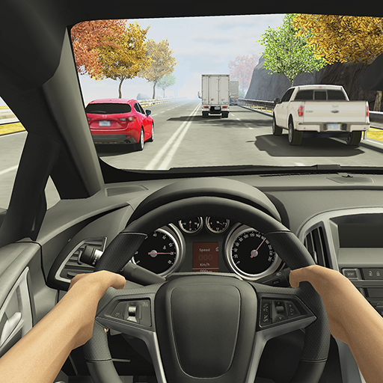
Example of the User’s View
First person view
Cockpit of car
Road environment
UK roads/cars unlike this image (E.g. left side of the road, wheel on right side of the car, etc.)
Image source: “Racing in Car 2” screenshot
https://play.google.com/store/apps/details?id=com.ffgames.racingincar2&hl=en

Slide 17


Software
GitHub: (Free Version)
For file management, version control, and backups.
Unity 3D: (Free Version)
For creating & scripting 3d environments & scenes – the main application.
Autodesk Maya: (Student Version - Free)
For creating realistic 3D models that can be textured, animated, & used as an asset within unity. It is industry standard.

Slide 18
Planning

Slide 19
Project Objectives
Become skilled and experienced using Unity in a 3D environment.
Learn how to program for Virtual Reality hardware.
Have a successful experiment, where at least 10 different people are tested & reliable data is collected.
Research different literature & data for both real and simulated experiments in similar areas.
Learn basic 3D modelling in Maya (as it’s industry standard).
Stick to a schedule and complete tasks on time.

Slide 20
Tasks & Milestones
https://redbooth.com/a/#!/projects/2090216/gantt

Slide 21
Progress So Far:
Setup Unity Project with GitHub (made sure only the appropriate files are committed too).
Drafts of Aims, Objectives, and Literature Review completed.
Milestones and basic timeline complete (plus to-do list for specific tasks).
Basic design decisions made (scenes and variables, data to be collected, device relationships, etc.)
Tutorials for basic 3D modelling within Maya started.
References for literature and for code (so far) recorded within documents.

Slide 22

Thank you for listening! Any Questions?

